Slide 1
A modern Data Platform
Jan Cordtz,
Senior Cloud Solution Architect
Microsoft Denmark

Slide 2
Agenda / topics
What would we like to do with our data ?
Why is cloud interesting ?
Artificial Intelligence as in AI/ML/Gen/Agentic AI
A data platform – what it could look like
Overall theme – compliance, governance and cost-aware

Slide 3
Data – how to use them

Slide 4
Reporting
Analytics
AI/ML/GenAI
A piece of data
Self-Service
Shareable
The Data Platform
Extract/Transform/Load
Compliance/Governance
Access Control
Sources

Slide 5
A portal / Homepage / Dashboard / …..
A piece of data
Standard reporting
The Data Platform
Data Warehousing
Systems
Files/Databases

Slide 6
The Cloud

Slide 7
Cloud Models
Traditional
IaaS
PaaS
SaaS
You Manage
Applications
Applications
Applications
Applications
Data
You Manage
Data
Data
Data
Runtime
Runtime
Runtime
Runtime
Managed by Microsoft
You Manage
Middleware
Middleware
Middleware
Managed by Microsoft
Middleware
Operating System
Operating System
Managed by Microsoft
Operating System
Operating System
Virtualization
Virtualization
Virtualization
Virtualization
Servers
Servers
Servers
Servers
Storage
Storage
Storage
Storage
Networking
Networking
Networking
Networking
Products
Functionality

Slide 8

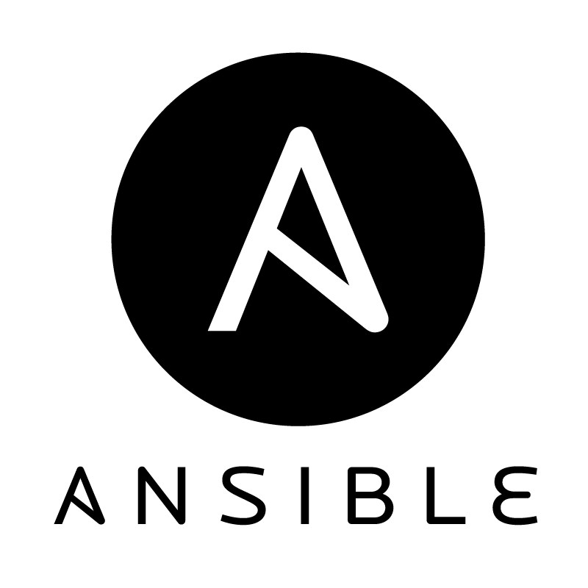





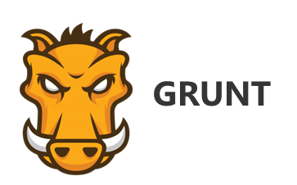



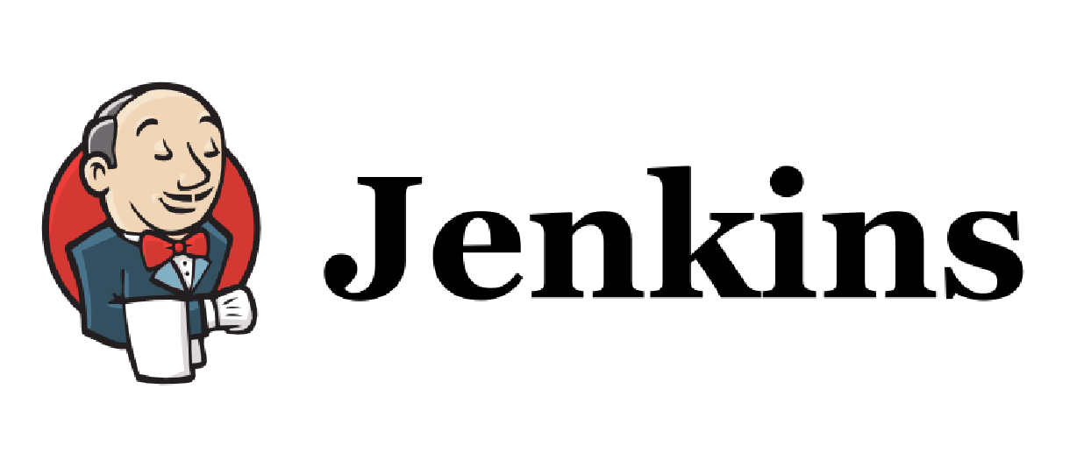



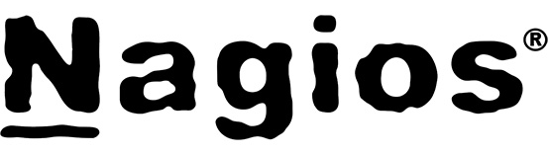



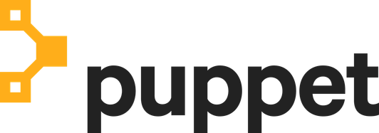

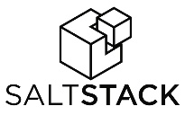
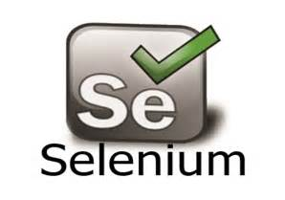


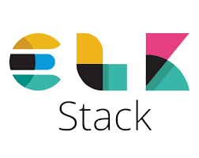
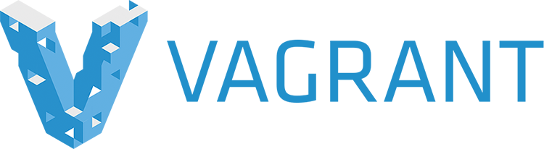
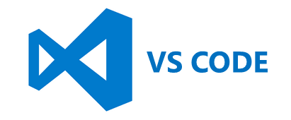

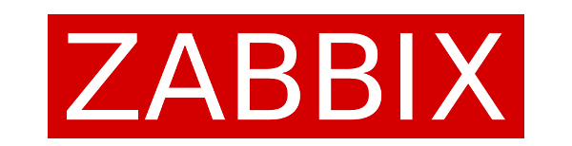
Azure runs what you need
Microsoft is one of the biggest OpenSource contributors
Notes:
Product truth is here now!
Azure is designed to support the open source ecosystem from Management to Apps to Databases and Middelware to Infrastructure and App Frameworks.

Slide 9
A data platform “Future proof”

Slide 10
Data : Capabilities
Capability | Description
Consistency | A consistent solution design to ensure simple operation and further development of solutions. Replacing resources must be flexible.
Modulated | Solutions in the data infrastructure are developed modularly with a well-defined interface, so it is easy to replace subcomponents.
Technology independency | The architecture must be independent of the technology being used. This means that no matter what technology is being used, the different processes, functionalities and layers are the same.
Scalability | Scalability (up/down) is part of the solution design from the beginning, so that implementation and operations are not affected by bottlenecks, downtime or a possible mandatory purchase of unforeseen licenses.
Agility | The focus is on MVP (minimum viable product) and ongoing feedback to previous steps in the data flow. It is OK to fail, and solution designs must be tested as soon as possible during the development process.
Security | Security is incorporated into the general architecture as well as in the concrete solution designs, both in terms of information security and privacy.
Data encapsulation | Data in the data infrastructure is accessed through an interface that enables control of who has access to what. The interface allows you to make changes to the data infrastructure without affecting external systems.
Reuse | Solutions are being developed for reuse. The architecture will consist of templates for solution designs that shorten time-to-market and ensure standardization.
Feedback | The architecture is continuously adapted and improved based on feedback from the different users of data.

Slide 11
Source systems
Streaming/events
Ingest/Bronze
Characteristics
Consume raw data
High degree of integration points
Very technical
No transformation
Transform/Silver
Characteristics
Technical usable data
Getting data from ingest layer - only
Very technical
Place for technical transformations
Adhere to company chosen standards
Publish/Gold
Characteristics
Business useable datasets
Datasets placed in whatever suitable technology for the end usage
“Lives” as long as being used
Can be recreated (by self-service)
Consume
Characteristics
End user tools
Business Intelligence
Reporting
Machine Learning
Artificial Intelligence
Source systems
Batch
Supporting Data Services
Data Catalog | Common Data Model | Data Discovery | Data Lineage | Data Governance | Master Data

Slide 12

Delay: X min
Source systems
Streaming/events
Real time
Ingest/Bronze
Characteristics
Consume raw data
High degree of integration points
Very technical
No transformation
Transform/Silver
Characteristics
Technical usable data
Getting data from ingest layer - only
Very technical
Place for technical transformations
Adhere to company chosen standards
Publish/Gold
Characteristics
Business useable datasets
Datasets placed in whatever suitable technology for the end usage
“Lives” as long as being used
Can be recreated (by self-service)
Consume
Characteristics
End user tools
Business Intelligence
Reporting
Machine Learning
Artificial Intelligence
Near Real time
Source systems
Batch
Alternatives
Data
Data
Datasets
Datasets
Supporting Data Services
Data Catalog | Common Data Model | Data Discovery | Data Lineage | Data Governance | Master Data

Slide 13
Source systems
Streaming/events
Tables
Agents
Ingest/Bronze
Characteristics
Consume raw data
High degree of integration points
Very technical
No transformation
Transform/Silver
Characteristics
Technical usable data
Getting data from ingest layer - only
Very technical
Place for technical transformations
Adhere to company chosen standards
Publish/Gold
Characteristics
Business useable datasets
Datasets placed in whatever suitable technology for the end usage
“Lives” as long as being used
Can be recreated (by self-service)
Consume
Characteristics
End user tools
Business Intelligence
Reporting
Machine Learning
Artificial Intelligence
Consume
Karakteristika
Slutbrugerværktøjer Business Intelligence Rapportering Machine Learning Kunstig intelligens
Consume
Characteristics
End user tools
Business Intelligence
Reporting
Machine Learning
Artificial Intelligence
Master
Agent
Near Real time
Source systems
Batch
Data
Data
Datasets
Datasets
Datasets
Datasets
Supporting Data Services
Data Catalog | Common Data Model | Data Discovery | Data Lineage | Data Governance | Master Data

Slide 14





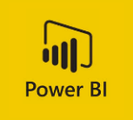
The purpose of a dataplatform
Access
Design
App 1
Ingest Transform
Publish
Ingest Area
Raw
Transform Area
Useable (Standard)
1
Data Product A
System Owner 1
1
Data User 1
1
1
App 2
1+2-3
Data
Data Product B
2
2
1+2-3
System Owner 2
Data User 2
Data Product C
2-3
3
3
Data
App 3
2-3
Transform
Data User 3
System Owner 3

Slide 15
How to……

Slide 16
1
Repo
2
Trans-form
Limitation Anonymization Pseudomisization
Project room
Store
Tools
3
Source systems
Streaming/ Events
Ingest/Bronze
Transform/Silver
1
Publish/Gold
Consume
Store
Store
Besked
Copy
Store
Store
Læse-adgang
Trans-form
Data Marts
Store
Store
Trans-form
Store
Store
Store
Source systems Batch
Copy
Trans-form
Store
Store
Batch
Data
Data
Enterprise Data Warehouse
Dataset
Dataset
Supplemental Data Services
Data Catalog | Common Data Model | Data Discovery | Data Lineage | Data Governance | Master Data

Slide 17






Azure (PaaS)
Azure DevOps/
Github
Trans-form
Limitation Anonymization Pseudomisization
Project room
Source systems
Streaming/ Events
Ingest/Bronze
Transform/Silver
Publish/Gold
Consume
besked
Copy
Data Marts
Trans-form
Source system
Batch
Copy
Trans-form
Batch
Enterprise Data Warehouse
Supplemental Data Services
Data Catalog | Common Data Model | Data Discovery | Data Lineage | Data Governance | Master Data

Slide 18
Azure
Databricks (PaaS)
Azure DevOps/
Github
Trans-form
Limitation Anonymization Pseudomisization
Project room
Source systems Streaming/Events
Ingest/Bronze
Transform/Silver
Publish/Gold
Consume
besked
Copy
Data Marts
Trans-form
Source systems Batch
Copy
Trans-form
Batch
Enterprise Data Warehouse
Supplemental Data Services
Data Catalog | Common Data Model | Data Discovery | Data Lineage | Data Governance | Master Data

Slide 19

Fabric (SaaS)
Azure DevOps/
Github
Source systems
Streaming/events
Ingest/Bronze
Transform/Silver
Publish/Gold
Consume
Store
Store
Message
Copy
Store
Store
Read-able
Trans-form
Data Marts
Store
Store
Trans-form
Store
Store
Store
Source systems
Batch
Copy
Trans-form
Store
Store
Batch
Data
Data
Enterprise Data Warehouse
Datasets
Datasets
Supporting Data Services
Data Catalog | Common Data Model | Data Discovery | Data Lineage | Data Governance | Master Data

Slide 20
Security and DevOps

Slide 21
Protection
Application Based Access Control
Access controlled through the application
Role Based Access Control Access control for accessing a resource
Data Store
Removal Based Access Control If (when) “attacked” remove the service
Attribute Based Access Control
Access control provided through a “lookup”
Encryption Based Access Control You need a key to read the data
Identity Based Access Control An application also have an identity

Slide 22
Pipeline Workflow
This show an overall workflow for the movement of code/data in a DataOps scenario
Self Service
Self Service
Project room
Approval Gate
Non-Prod
Development
Quality Assurance
Test
Production
PreProduction
Production

Slide 23
Data : Environments / Pipelines
Release Pipeline
Sandbox
Development
QA
Test
Pre-production
Production
Sandbox 1
Workspace
Prod Tools/apps
QA area
Test area
Pre-prod Tools/apps
Project area
Sandbox 2
Tools IaC Pipeline
Prod Tool IaC
Sandbox 3
Data
Test Data
Pre-prod Data
Prod Data
Data
Sandbox N
Data IaC Pipeline
Pre-Prod Data IaC
Time limited Environment
Permanent Environment

Slide 24
Possible setup

Slide 25
“Many data platforms”
Common data sets
Trans-form
Publish
“Dept 1” data sets
Dept 1/ Source A
Ingest
Trans-form
Trans-form
Publish
Consume
“Dept 2” data sets
Dept 2/
Source B
Ingest
Trans-form
Trans-form
Publish
Consume

Slide 26
Thank you
Jan.Cordtz@microsoft.com
https://github.com/jcordtz/a_data_platform

Slide 27
Appendix

Slide 28



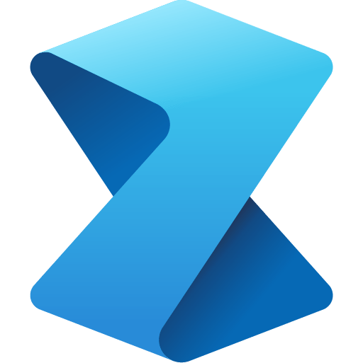


Intelligent data foundation
Data Factory
Data Engineering
Data Warehouse
Data Science
Real Time Analytics
Power BI
Data Activator
Powered by AI with Copilot in Microsoft Fabric
Single data foundation
OneLake
UNIFIED
SaaS product experience
Security and governance
Compute and storage
Business model

Slide 29
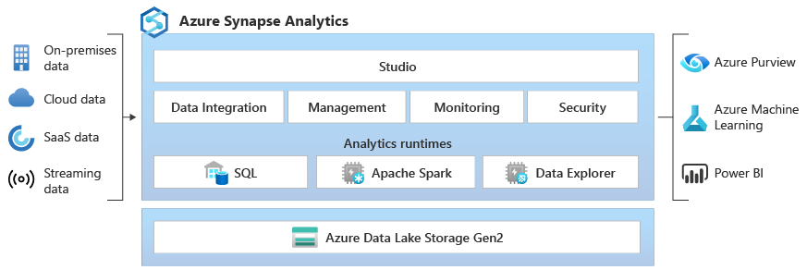

Slide 30
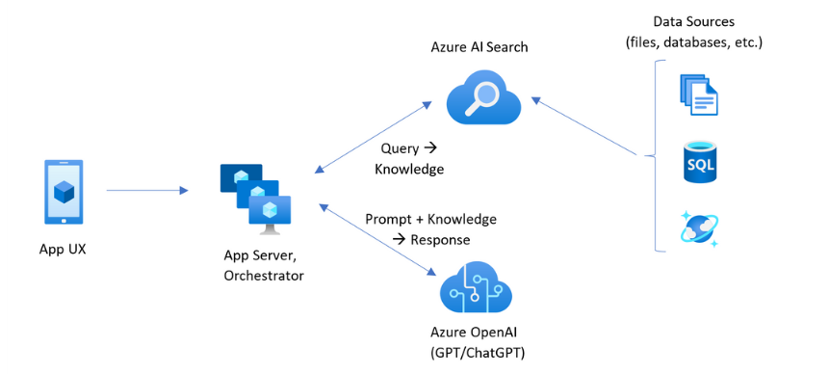

Slide 31
Ingest model
Type: Tabel model
Description:
Outcome: Good/bad records
Transform model
Type: Aligned Tabel model
Description
Outcome: Easy to join structures
Publish Model
Type: Dimensional Model
Description:
Outcome: Data Products aligned with business needs
Consume model
Type : Data Products
Description :
Outcome: Business focused documentation
Ingest/bronze
Characteristics
Consume raw data
High degree of integration points
Very technical
No transformation
Transform/silver
Characteristics
Technical usable data
Getting data from ingest layer - only
Very technical
Place for technical transformations
Adhere to company chosen standards
Publish/gold
Characteristics
Business useable datasets
Datasets placed in whatever suitable technology for the end usage
“Lives” as long as being used
Can be recreated (by self-service)
Consume
Characteristics
End user tools
Business Intelligence
Reporting
Machine Learning
Artificial Intelligence
Source systems
Streaming/events
Source systems
Batch
Data
Data
Datasets
Datasets
Supporting Data Services
Data Catalog | Common Data Model | Data Discovery | Data Lineage | Data Governance | Master Data

Slide 32
Principal Agreement (MCA or MBSA & EA)
Product Terms
Universal License Terms
For Online Services
Privacy & Security Terms
Data Processing Addendum
Service-specific terms in “Product Offerings” (if applicable)

Slide 33
1
2
3
4
Your data is your data
Your data is not used to train or enrich foundation
AI models
Your data and AI models are protected at every step
Our Customer Copyright Commitment
Notes:
A couple of basics:
First, your data is your data. That means it is yours to own and control. And it is for you to choose how you want to leverage and monetize.
Your data is not used to train or enrich the foundational AI models used by others without your permission, so you don’t have to worry about anyone other than your organization benefiting from AI that is trained on your data.
And your data and AI models are protected at every step by the most comprehensive enterprise compliance and security controls in the industry.
You’re also protected through our customer copyright commitment, where Microsoft will defend customers from IP infringement claims arising from the customer's use and distribution of the output content generated by Microsoft’s Copilot services and Azure OpenAI model, as long as the customer used the guardrails and content filters we have built into our products or provided.
That’s how confident we are in our safety systems.

Slide 34
Contractual Compliance
Demonstrated Compliance
Adopted Compliance
Data Processing Agreement
Audit & Inspection
Technical & security measures and tools for organizational use
Contractual Compliance defines the obligations
Adopted Compliance is compliance in action
“On which Terms”
“The how & the what”
“What I get”
Shared Responsibility

Slide 35
Microsoft Approach for Data Security and Data Compliance in Online Services
Shared Responsibility
Contractual Compliance
Demonstrated Compliance
Adopted Compliance
Commercial Executive Lead
Customer self-service
STU, CSU & Partners
Product Terns and DPA
Service Assurance
Technical & security measures and tools for organizational use
DPA is has general obligations
Product-specific terms and Product Documentation has specific terms and guidance.
Learn descriptions of Datacenter operations & controls design to safeguards customer data
Learn Training & education paths
Data security tools
Encryption, Customer Lockbox etc.
One general DPA for Products (Online Services and Software) and Professional Services
With different terms for:
Online Services Previews vs. Online Services vs. Core Online Services vs. EU Data Boundary Online Service
And reference to
Product-specific terms (for some)
Product Documentation describing specific data use scenarios and features for customer configuration.
docs.microsoft.com/compliance
learn.microsoft.com/docs
Third-party Certification & Audits
Microsoft controls based on various standards
Third-party attestation & certification (ISO, SOC etc.)
Penetration Testing
Third-part testing and by customers
servicetrust.microsoft.com
Compliance Program
© 2024 Microsoft Corporation. All rights reserved. Any use or distribution of these materials without express authorization of Microsoft is strictly prohibited.
White glove service available for annual fee

Slide 36
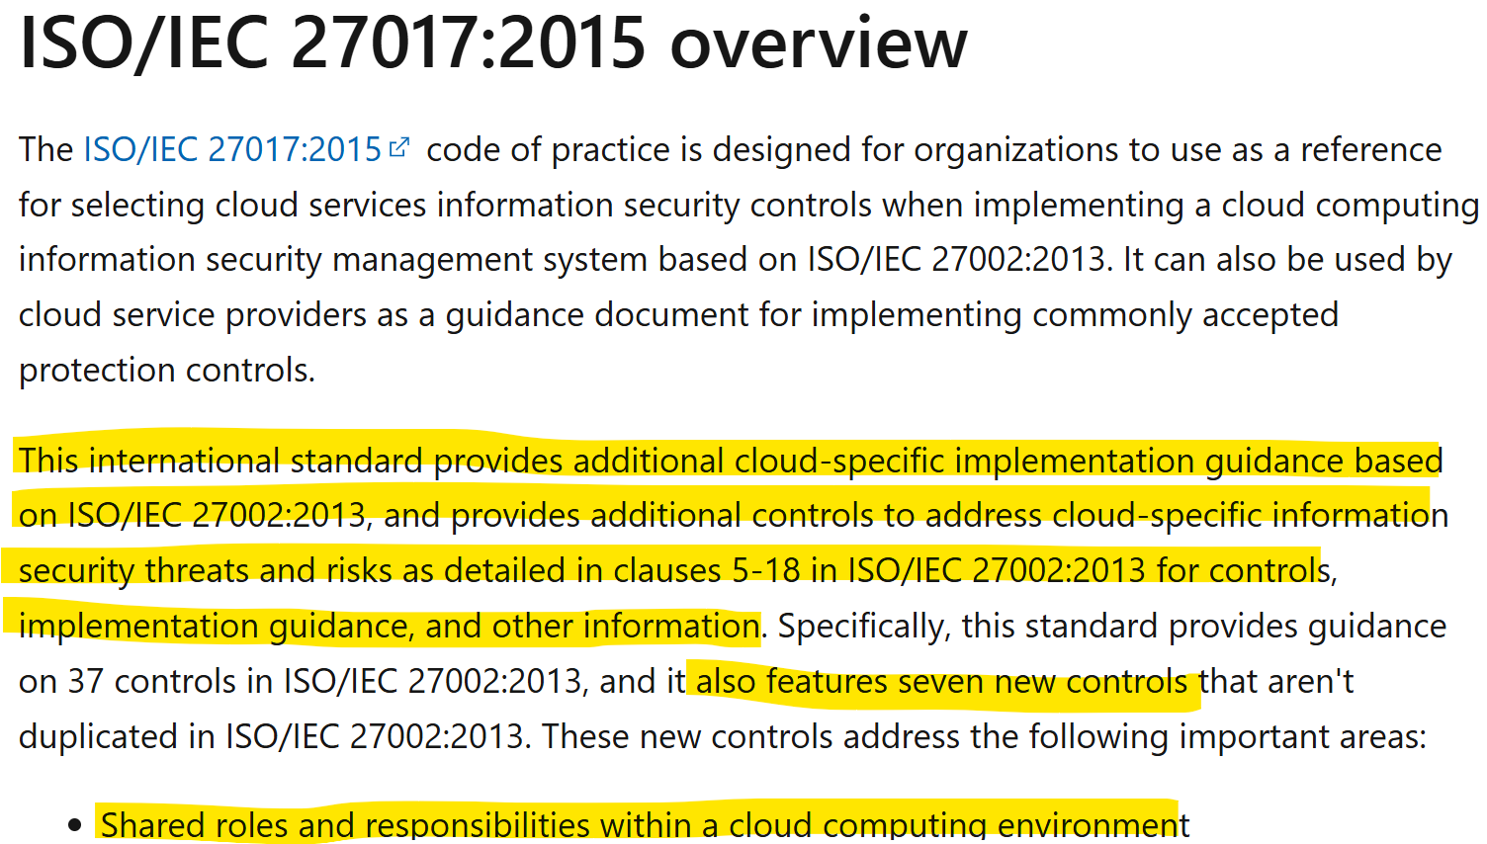
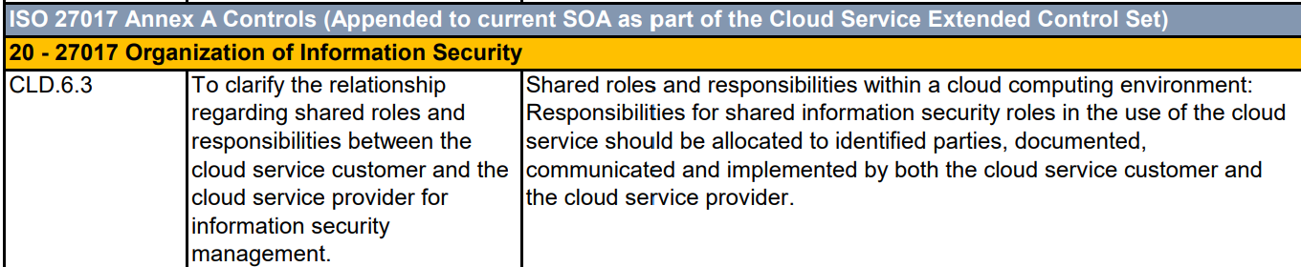
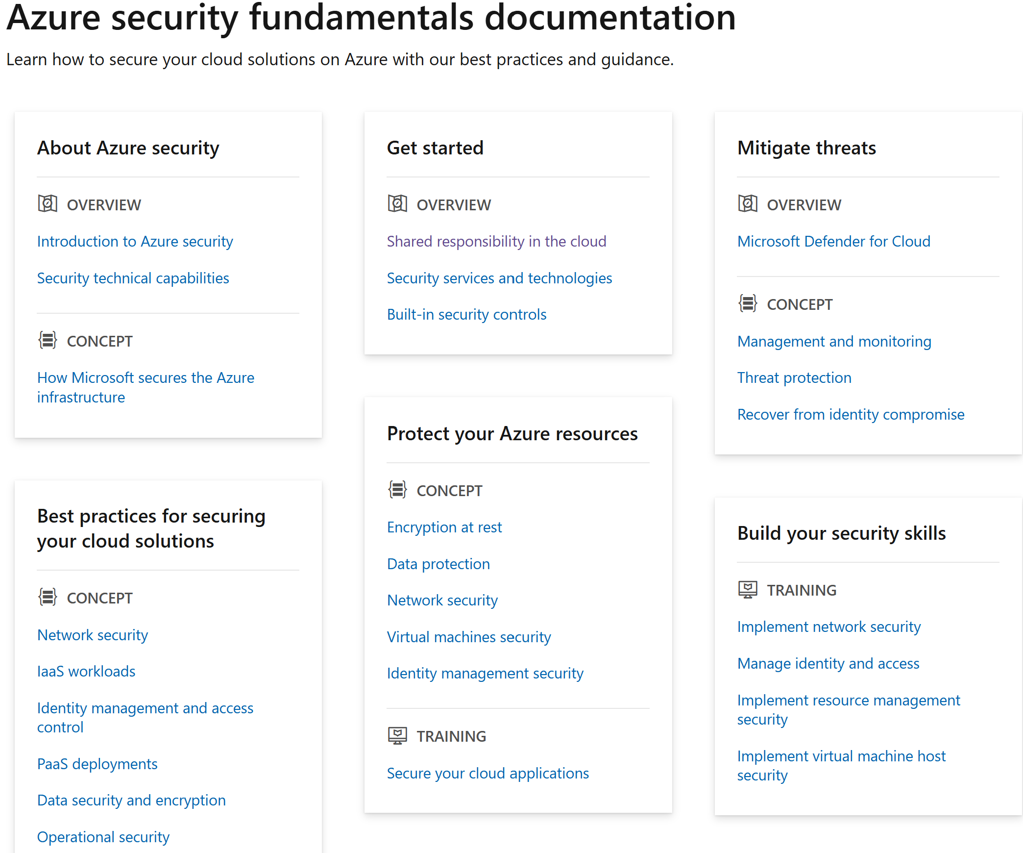
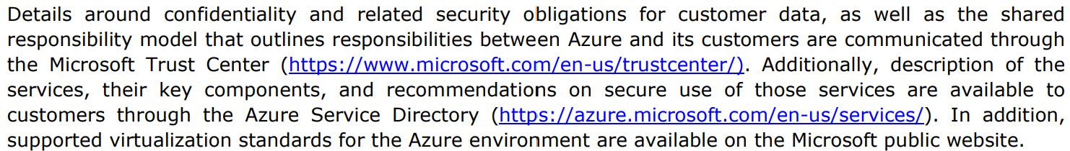
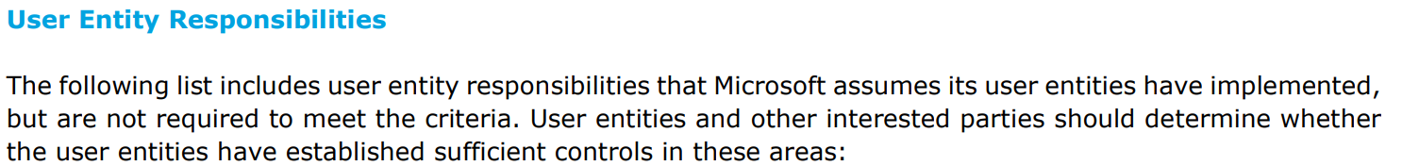
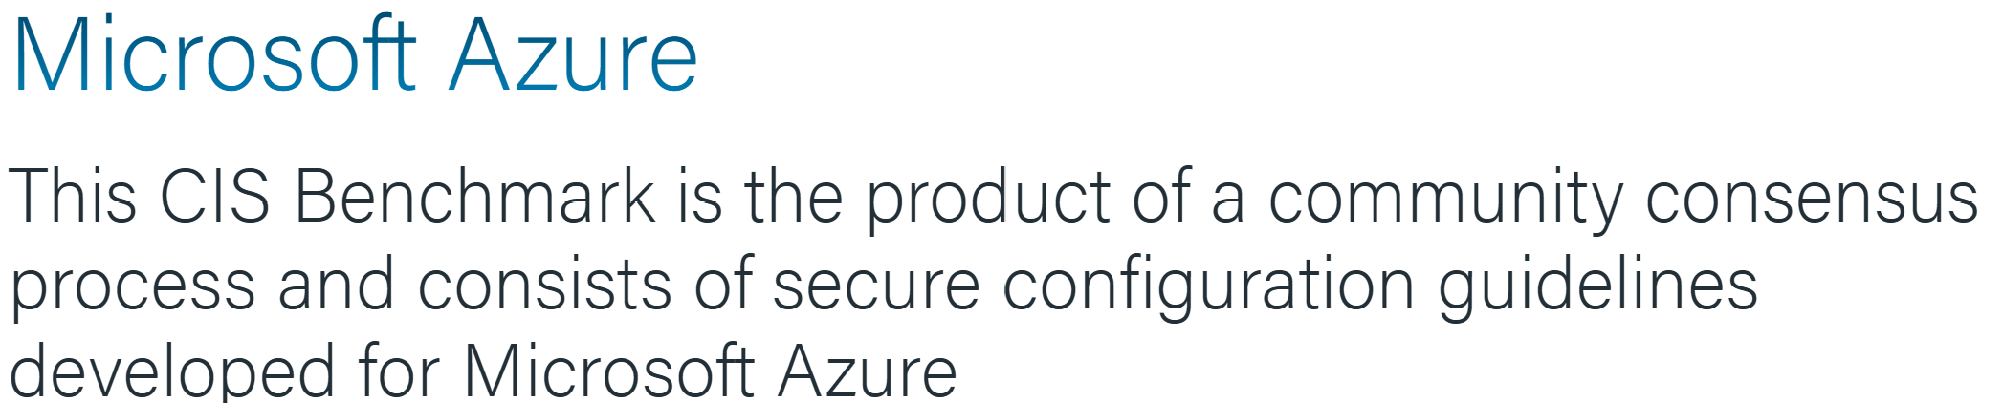
Shared Responsibility in the cloud? ISO requirement in 27017 – Azure example
SOC 1 Type II and SOC 2 Type II reports both lists Customer Responsibility in more detail – as “User Entity Responsibilities”
“User Entity Responsibilities” configuration guidance and advice
ISO/IEC 27017 - Azure Compliance | Microsoft Learn
Azure - Dynamics 365 - Online Services - ISO 27001, 27017, 27018 and 27701 Statement of Applicability (SOA) (1.9.2024)
Azure - Dynamics 365 - Online Services - Public & Government - SOC 2 Type II + C5 (04-01-2023 to 03-31-2024)
Azure security fundamentals documentation | Microsoft Learn
CIS Microsoft Azure Benchmarks (cisecurity.org)
© 2024 Microsoft Corporation. All rights reserved. Any use or distribution of these materials without express authorization of Microsoft is strictly prohibited.

Slide 37
Desired Customer Methods for “Being in Control” with Cloud Provider Risk factors
Regulatory Cloud Governance - how Customers assess and document “being in control” with Provider Risk factors.
Cross organisational Customer collaboration aimed at keeping all internal and external stakeholders satisfied
Contractual Compliance
Demonstrated Compliance
“On which Terms ?”
“The Microsoft how ?”
With Shared Responsibility
learn.microsoft.com/en-us/azure/security/fundamentals/shared-responsibility
learn.microsoft.com/en-us/azure/security/fundamentals/shared-responsibility-ai
Online Services Management / Cloud Governance for Shared Responsibility - how Customers use and configure for desired compliance
Customer IT / business owned / driven (anchored in Customer’s Cloud Center of Excellence)
“To be adopted” Compliance
Adopted Compliance
“How I do it & what I get ?”

Slide 38
SaaS PaaS IaaS On-prem
Information and data
Responsibility always
Retained by the customer
Devices (Mobile and PCs)
Accounts and identities
Identity and directory infrastructure
Applications
Responsibility varies by type
Network controls
Operating System
Physical hosts
Responsibility transfers
To cloud provider
Physical network
Physical datacenter

Slide 39
IaaS PaaS SaaS
BYO model Azure AI CoPilot
User training and accountability
AI Usage
Usage policy, admin controls
Identity, device and access management
Data Governance
AI Plugins and data connections
AI Application
Application design and implementation
Application infrastructure
Application safety systems
Model safety and security systems
Model accountability
AI Platform
Model tuning
Model design and implementation
Model training data governance
AI compute infrastructure

Slide 40
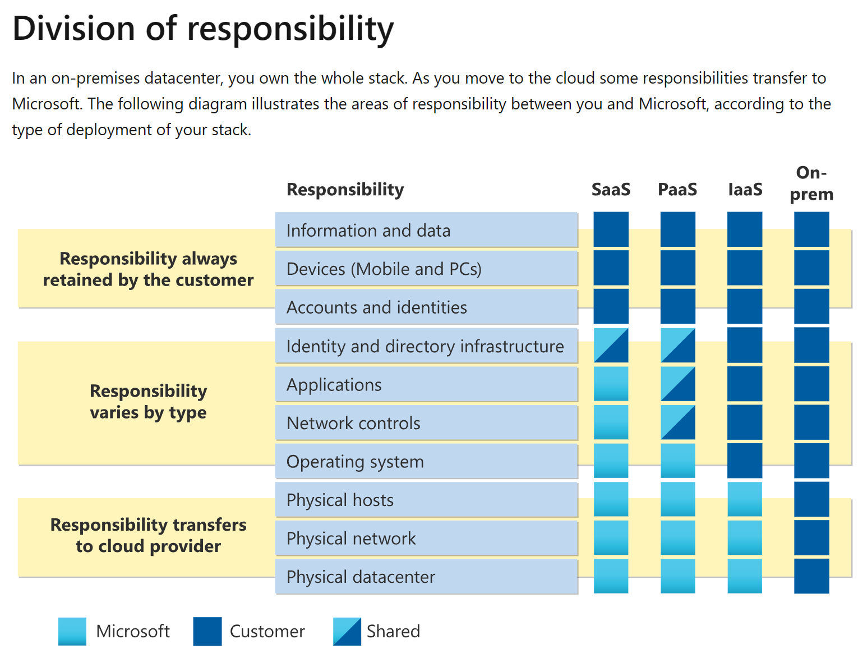



Shared Responsibility in the cloud?
Who to ask?
Resources to consult?
Customer Managed Controls / Supplementary Measures
Customer (IT / Service Owners) knows their data, use and configuration of features in Online Services
Microsoft Product Documentation
learn.microsoft.com/docs
Shared Controls / Technical Measures in Online Services
Customer (IT) knows their configuration of features in Online Services
Microsoft Product Documentation
learn.microsoft.com/docs
Microsoft Managed Controls / Technical and Organizational Measures
Microsoft (via self service)
Microsoft Service Assurance Documentation
docs.microsoft.com/compliance
Services Trust Portal
servicetrust.microsoft.com
Shared responsibility in the cloud - Microsoft Azure | Microsoft Learn

Slide 41
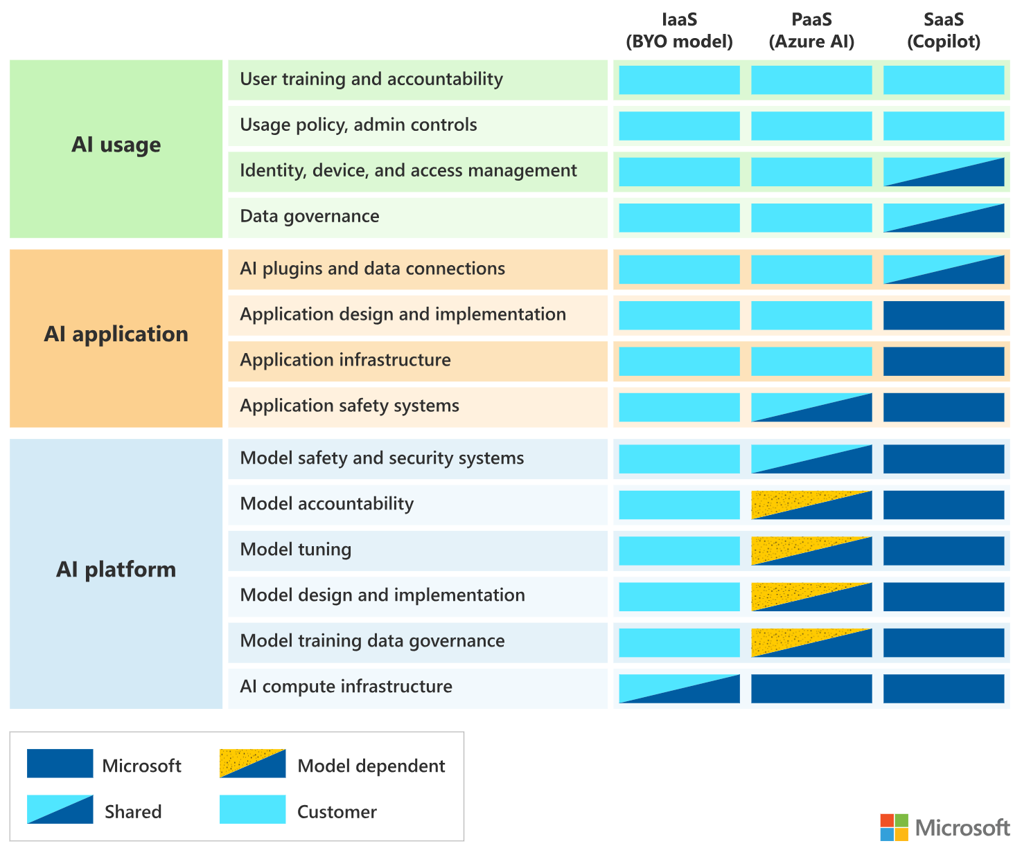




Artificial intelligence (AI) shared responsibility model
Who to ask?
Resources to consult?
Customer Managed Controls / Supplementary Measures
Customer (IT / Service Owners) knows their data, AI usage and configuration of features in Generative AI Services and is responsible for user AI training
Microsoft Product Documentation
learn.microsoft.com/docs
Shared Controls / Technical Measures in Online Services
Customer (IT) knows their configuration of features in Generative AI Services
Microsoft Product Documentation
learn.microsoft.com/docs
Model Dependent Shared Controls / Technical Measures in Online Services
Customer (IT) knows their configuration of features in Generative AI Services
Microsoft Product Documentation
learn.microsoft.com/docs
Microsoft Managed Controls / Technical and Organizational Measures
Microsoft (via self service)
Microsoft Product Documentation
learn.microsoft.com/docs
Microsoft Service Assurance Documentation
docs.microsoft.com/compliance
Services Trust Portal
servicetrust.microsoft.com
AI shared responsibility model - Microsoft Azure | Microsoft Learn

